Slide 1


University of Sadat City
Faculty of Computers and Artificial Intelligence
Student name :abanoub bekhiet abdallah
Department :computer science
Project idea
A website for jobs
a candidate search for a job and apply for one , upload his CV ,
His name ,email ,phone number and wait for the employee acceptance or rejection, and can make changes to his profile like adding skills ,experiences ,achievements , upload his cv ,and etc
An employee create post for a job and accept or reject the applications of the candidates ,see a list of all candidates profiles in the website and etc
An admin accept or reject employees posts can see a list of all the website candidates ,and employees
Next is the project details :

Slide 2
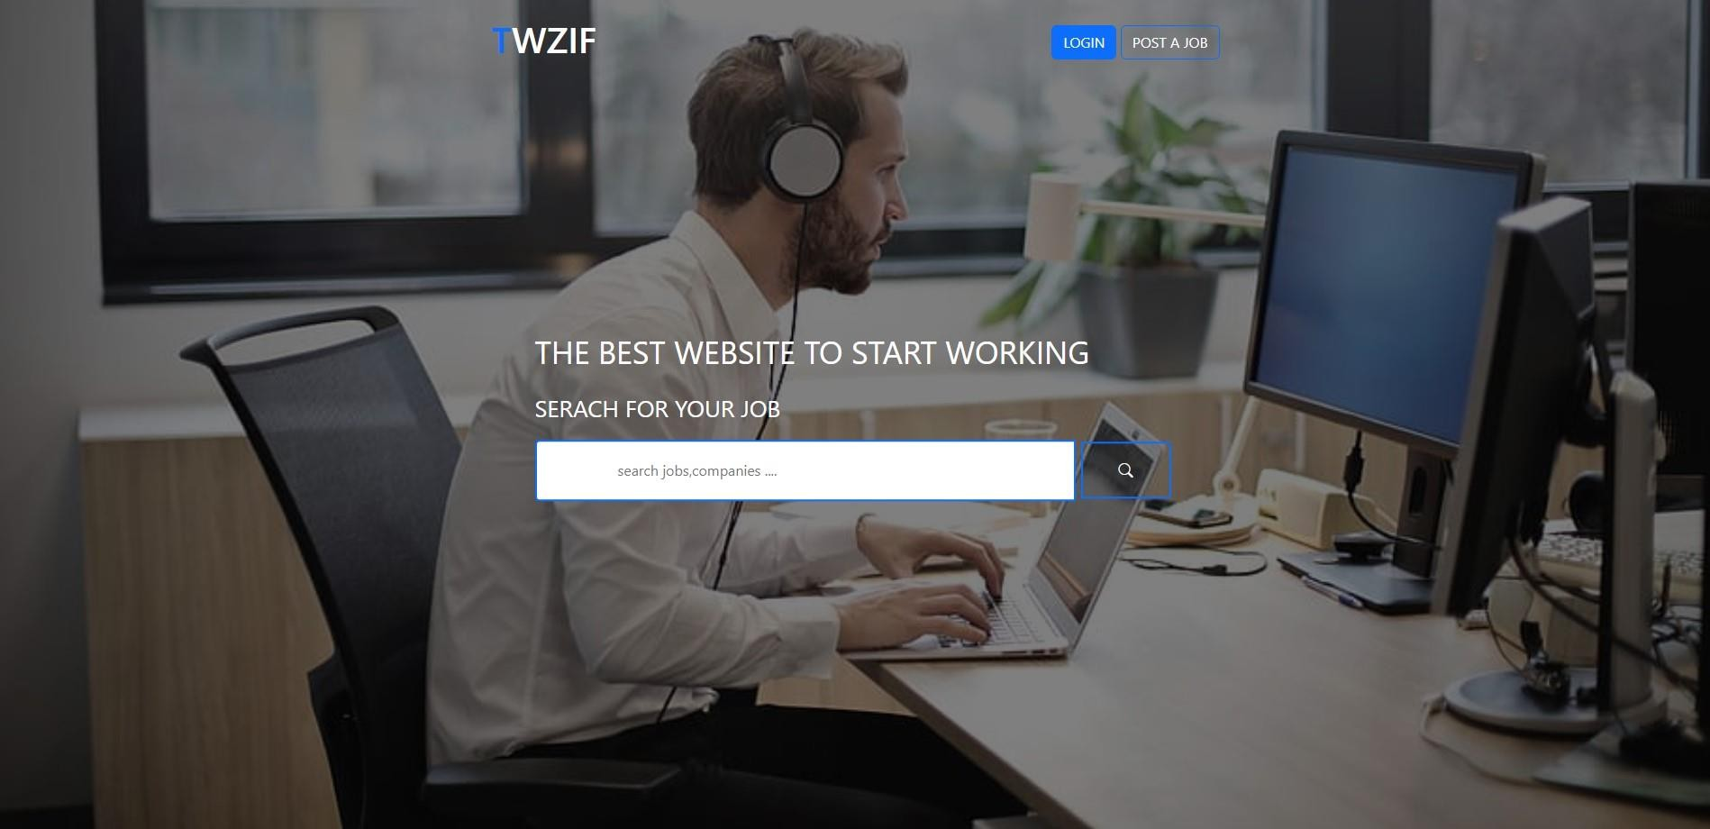
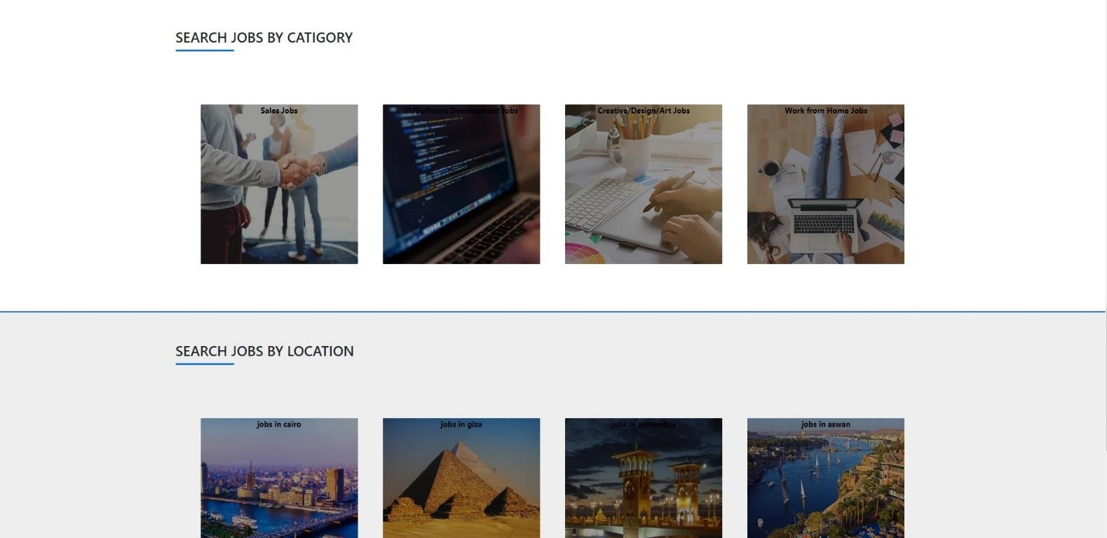
University of Sadat City
Faculty of Computers and Artificial Intelligence
The project content
1-the home page

Slide 3
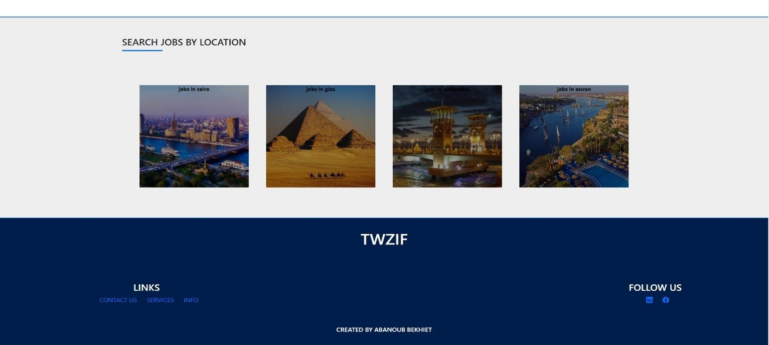
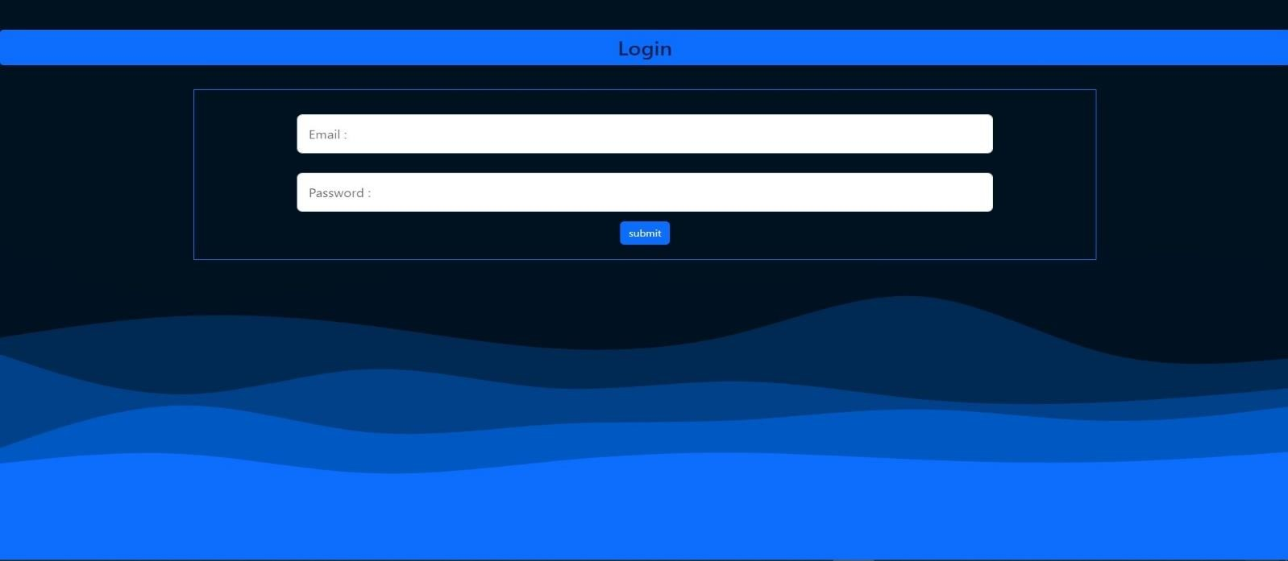
University of Sadat City
Faculty of Computers and Artificial Intelligence
2-login

Slide 4
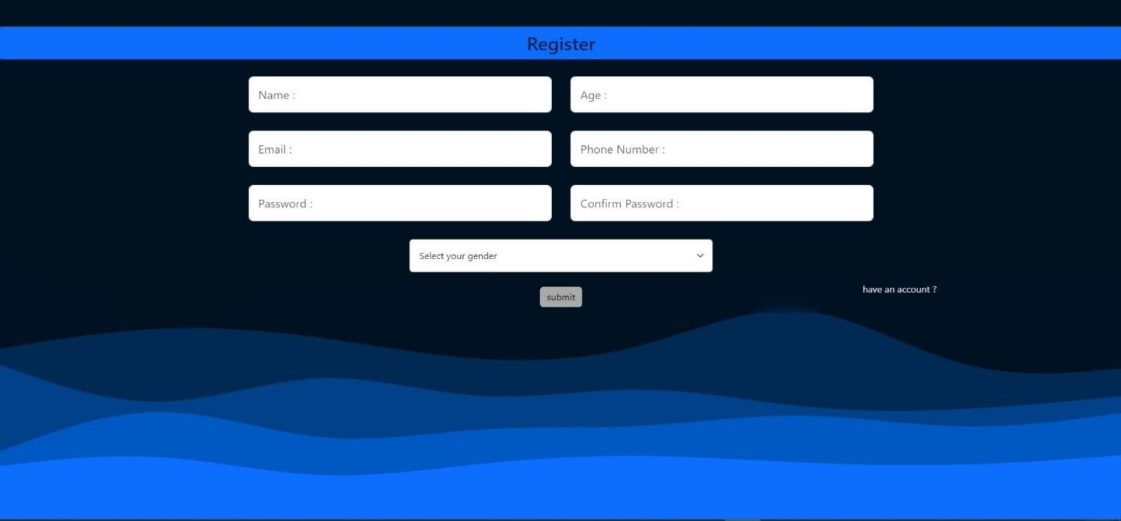
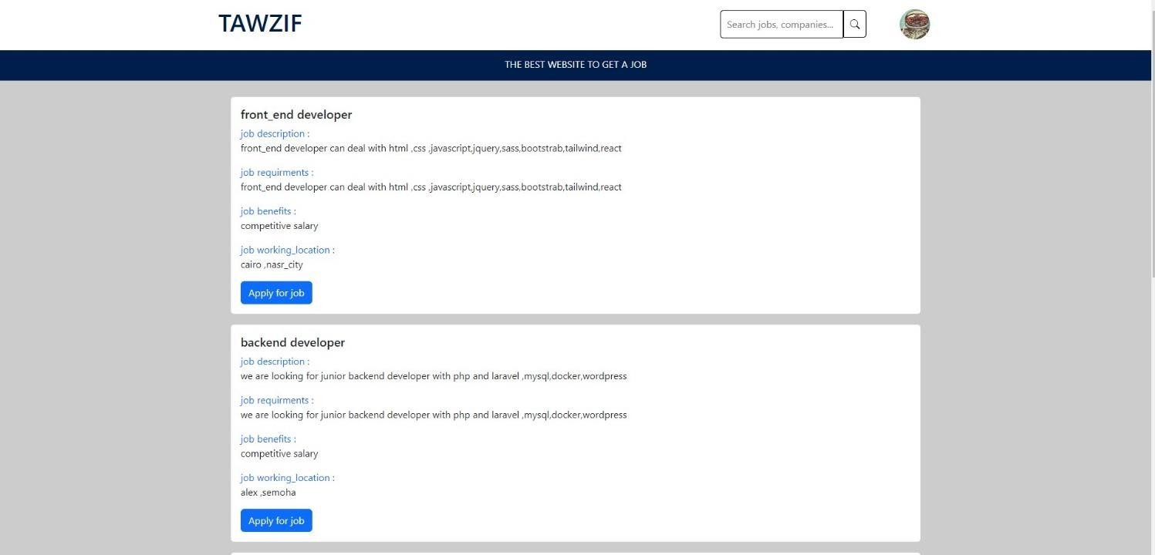
University of Sadat City
Faculty of Computers and Artificial Intelligence
3-Register
4-candidate after login (person who search for a job)
After candidate login been redirected to the page of all jobs in the website from all fields but in the top

Slide 5
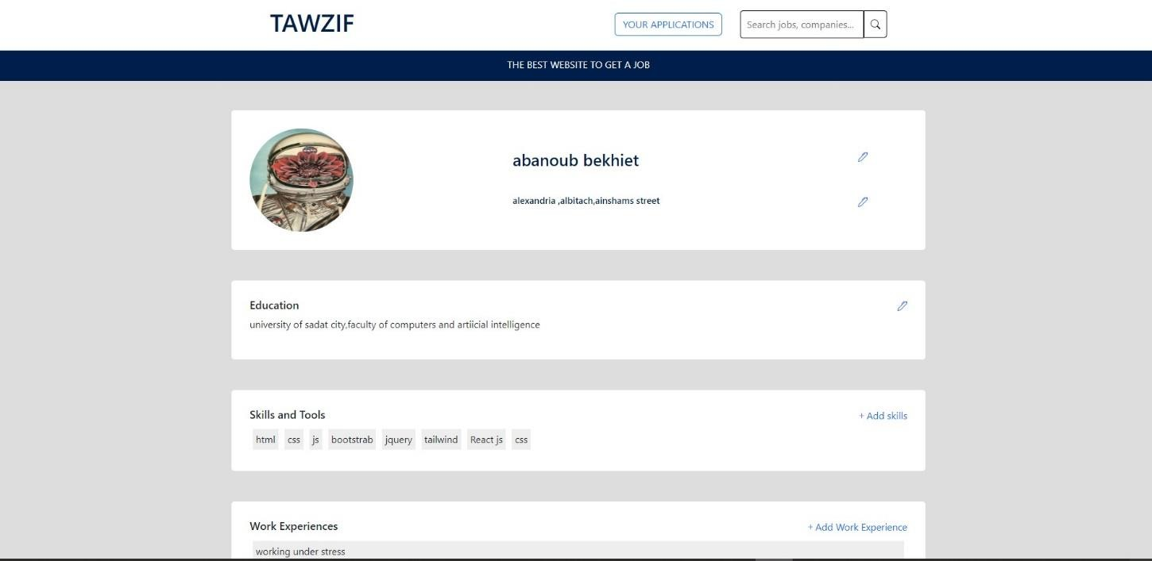
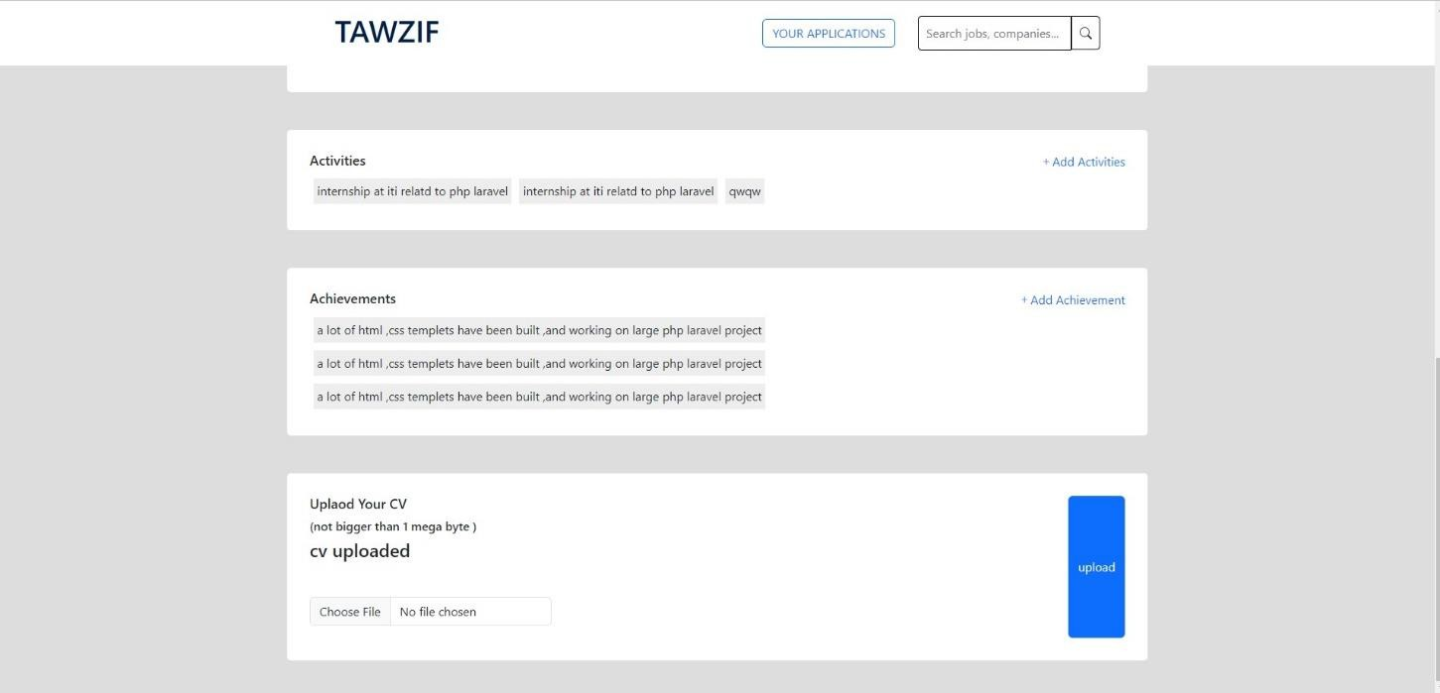
University of Sadat City
Faculty of Computers and Artificial Intelligence
of the page there is a search to find jobs in any field he want
5- candidate profile

Slide 6
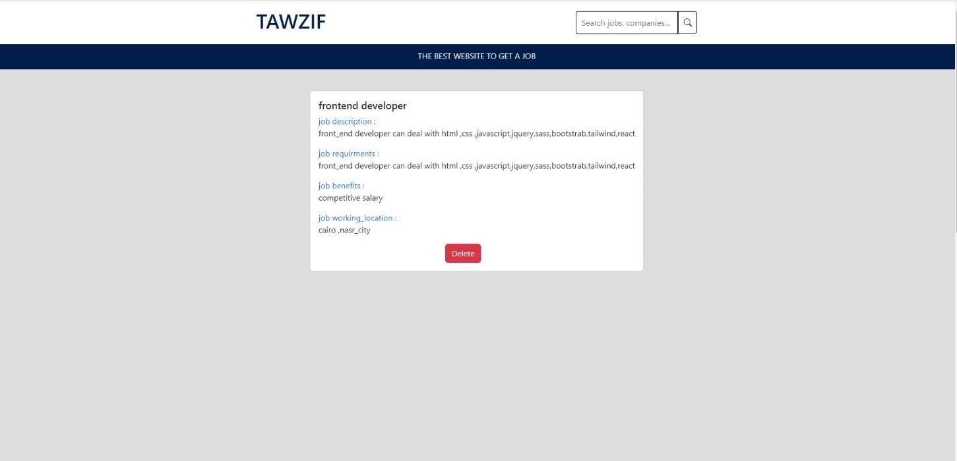
University of Sadat City
Faculty of Computers and Artificial Intelligence
And the candidate has also a profile he can upload his CV ,add education, skills, experience
,achievements ,his last projects ,his photo ,email
,and his name
6- candidate applications
There is also a page that display the candidate applications for the jobs and can delete this applications
7- employee (a person who post jobs) after login

Slide 7
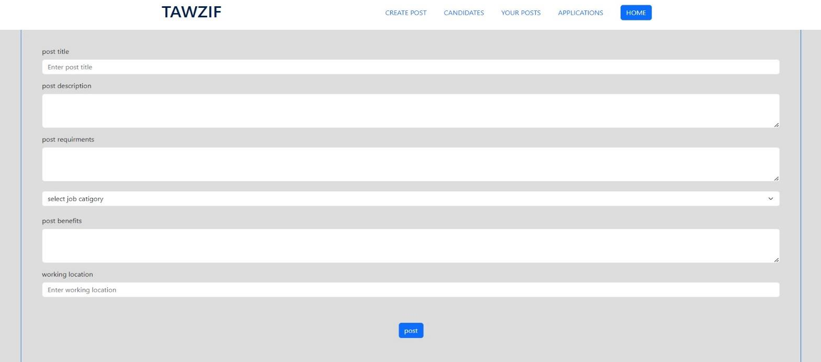
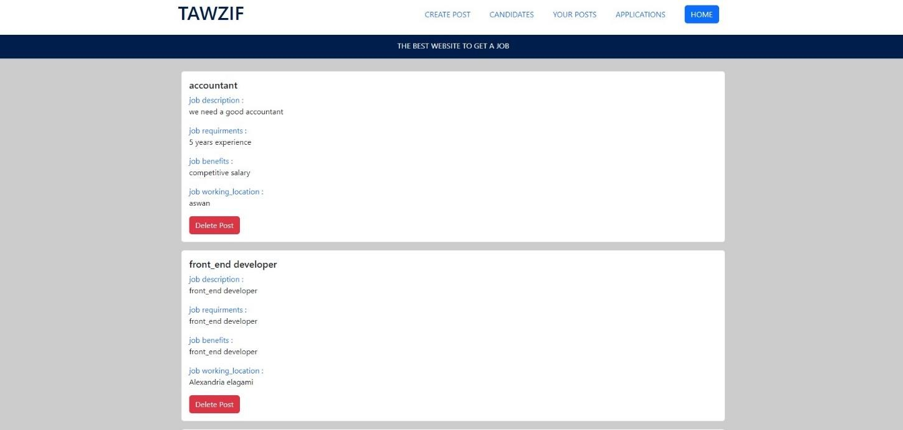
University of Sadat City
Faculty of Computers and Artificial Intelligence
After login he been redirected he a page to create post of a job and the post after that appears in the admin page waiting the admin to accept or reject it
8- employee posts

Slide 8
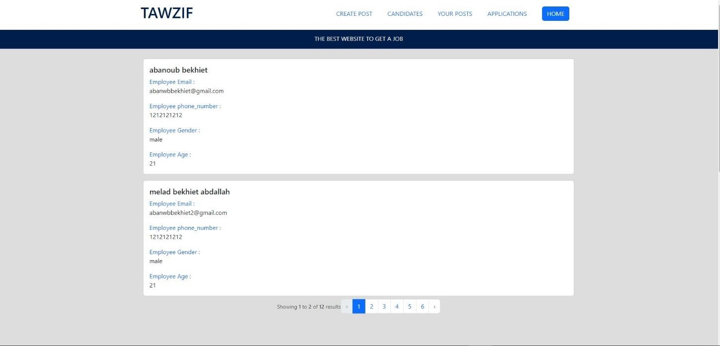
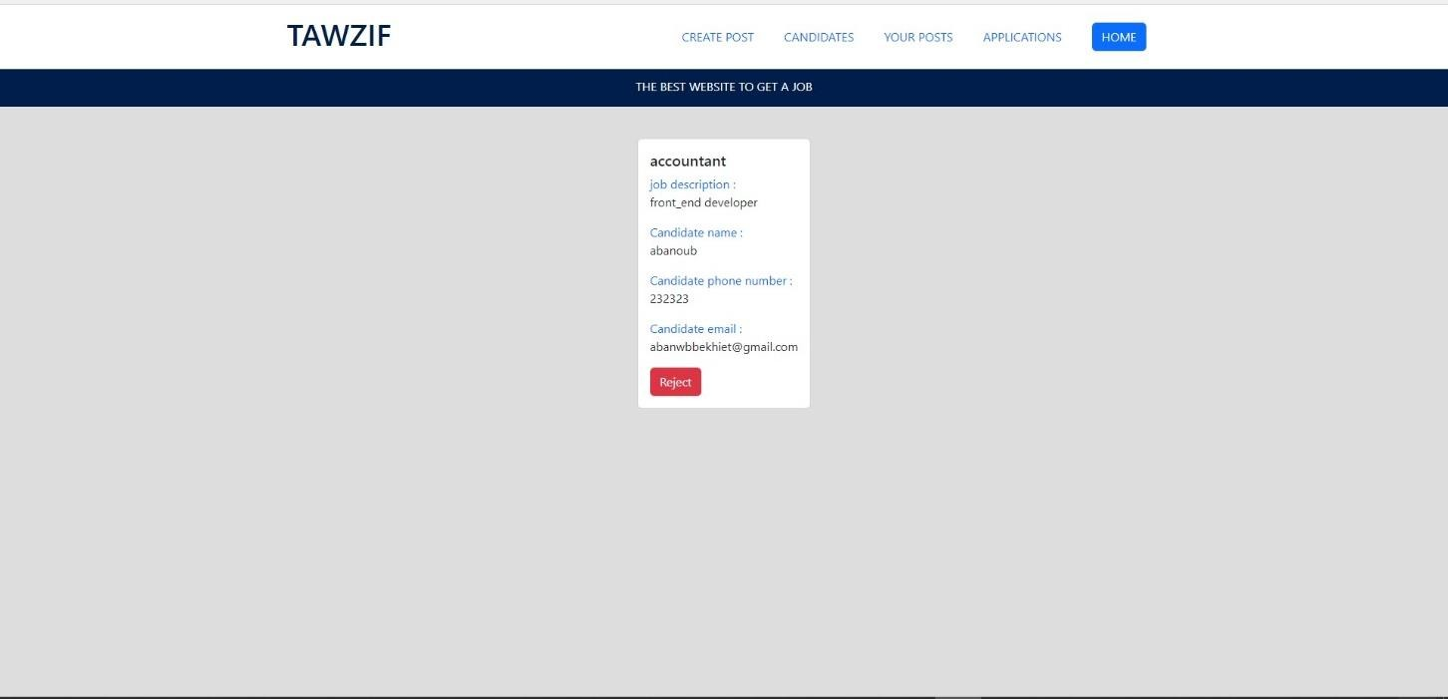
University of Sadat City
Faculty of Computers and Artificial Intelligence
Employee also can see his last posts and can delete them
9-list of candidates profiles in the employee page
Employee can see the candidates profiels and can contact with them
10- candidates applications
3
4

Slide 9
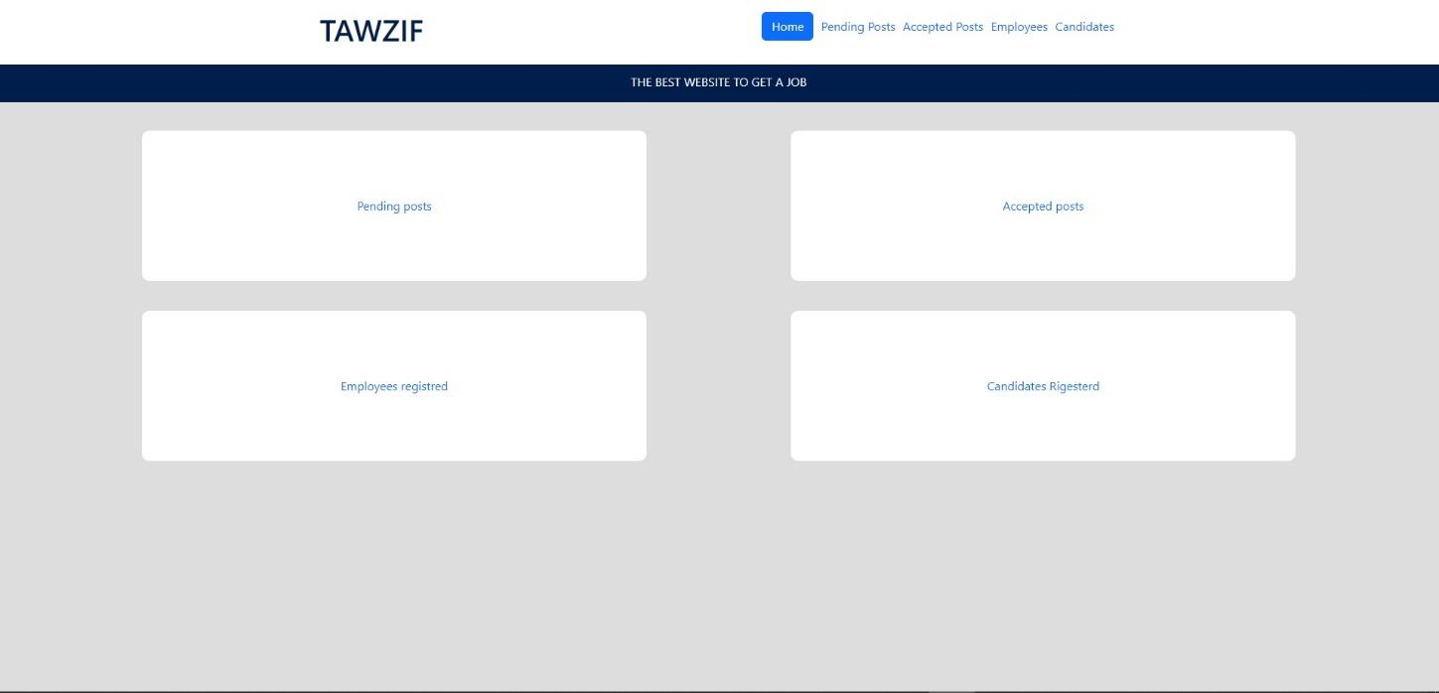
University of Sadat City
Faculty of Computers and Artificial Intelligence
Employee can see the applications of the candidates they post them
11-admin dashboard
After the login of the admin he is been redirected to the dashboard
That make he able to :
see the lists of pending posts and can accept or reject posts of employees
see list of the employees profiles
see list of the candidates profiles
see the list of accepted posts

Slide 10
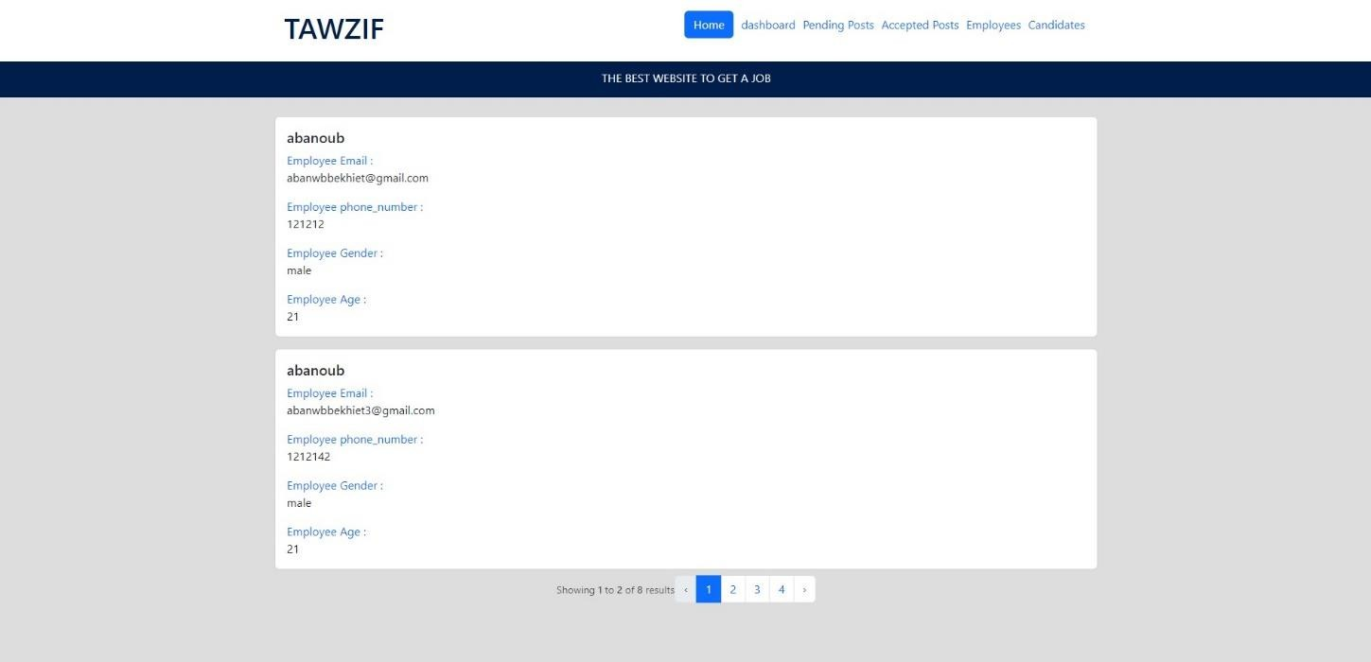
University of Sadat City
12-list of candidates admin can see
Faculty of Computers and Artificial Intelligence
13-list of employees admin can see

Slide 11
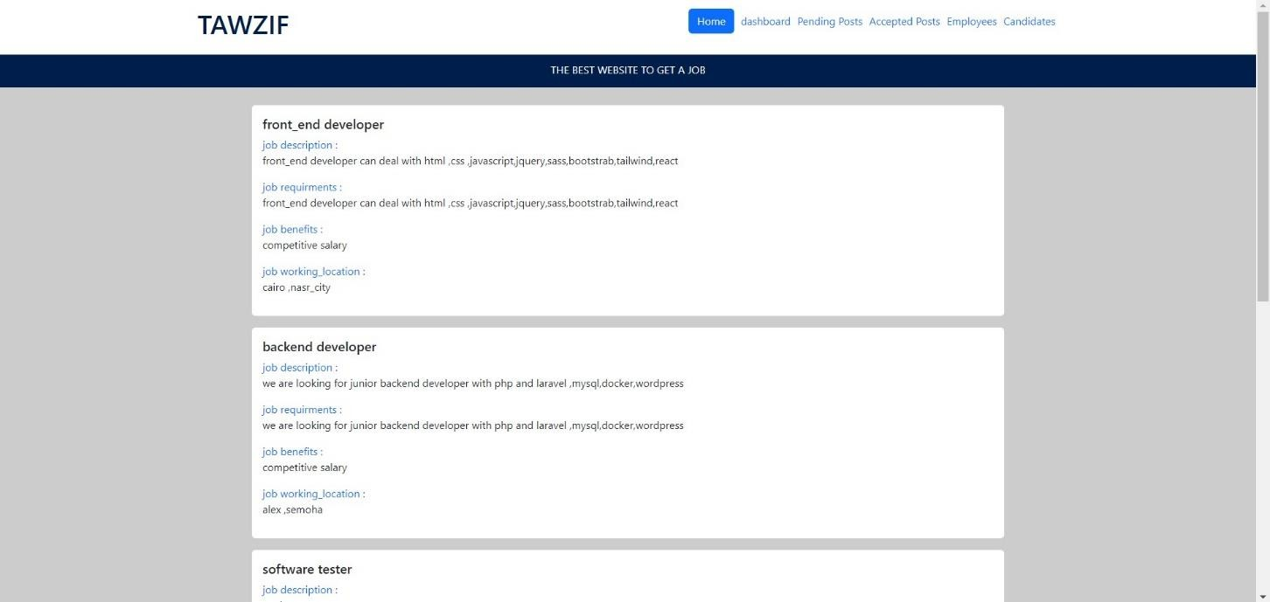
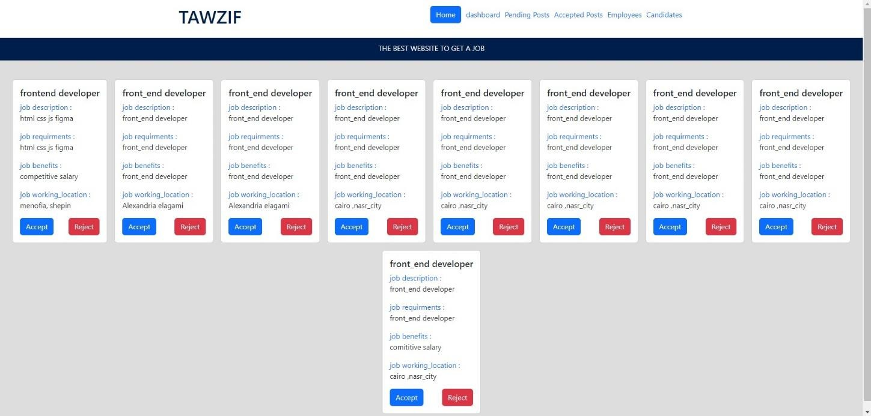
University of Sadat City
14- list of accepted posts admin can see it
Faculty of Computers and Artificial Intelligence
15-list of pending posts that admin can reject or accept

Slide 12
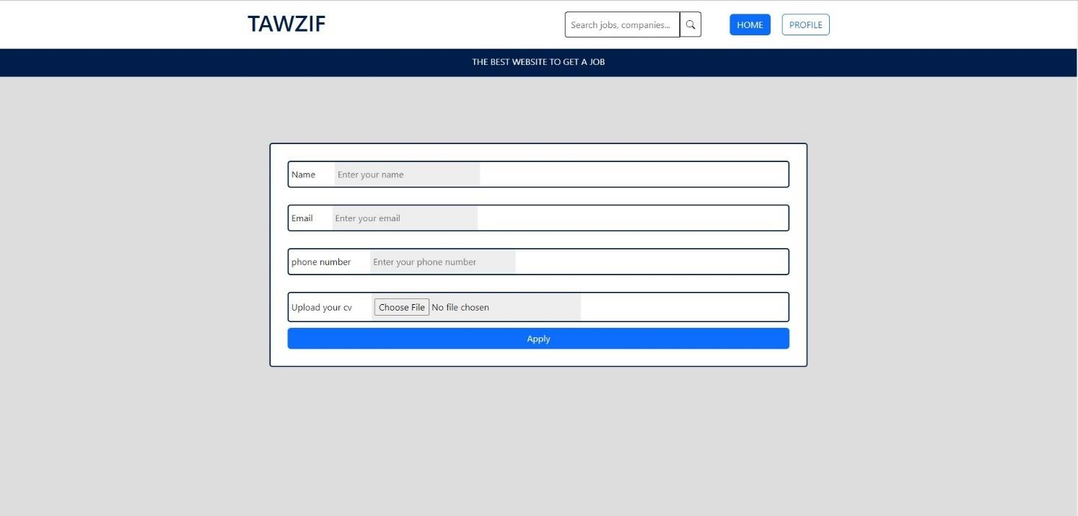
University of Sadat City
Faculty of Computers and Artificial Intelligence
16- form for applying for a job using the candidate That make him
upload a cv
write his name
write his email
write his phone number
This is all of the project and the internship content I hope this project gain your interest
Thank you for your time

